Slide 1
Donkey Kong Dominator
CSN-382 (Machine Learning)

Slide 2
Team Members
Kunal Bansal (22115083)
Shreya Jain (22114091)
Anjalika Singh (22114007)

Slide 3
Introduction
Our Project is about applying the reinforcement learning on the popular game Donkey Kong.
Donkey Kong arcade is a retro game released in 1981 for Nintendo 3DS.
The goal of the game is to reach the princess while a gorilla rolls down barrels to knock out the player.
The goal of our project is to train a ML agent that can play the game on its own without any human intervention.
We will try to achieve the desired results using a combination of machine learning techniques.

Slide 4
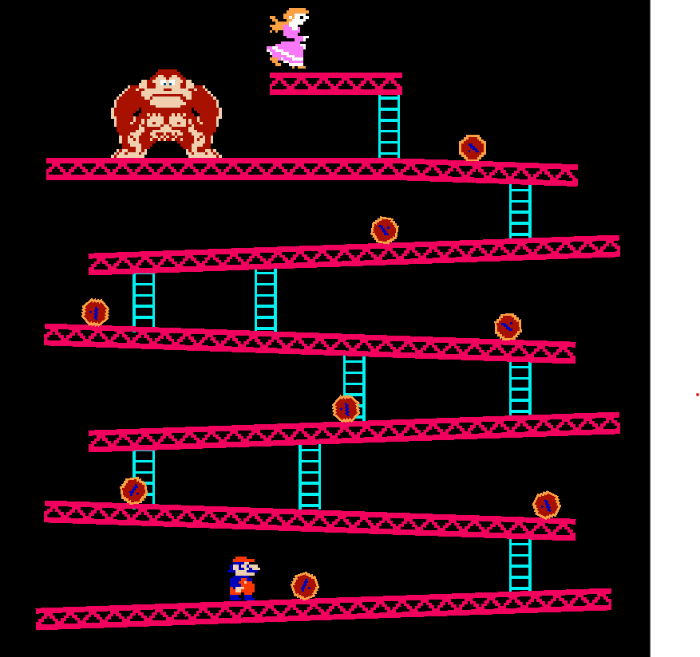
Game
Before training of the agent can begin, we need to create the environment i.e. the game.
The game has been remade using Unity2D and C#.
Although the game features multiple levels, we have decided to limit our project to a single level due to limited time and computing resources.

Slide 5
Training the Agent
The agent has been trained using a combination of various techniques namely Reinforcement Learning, Curriculum Learning and Imitation Learning using the popular mlagents package.
Reinforcement learning (RL) is a machine learning approach where an agent learns to make decisions by interacting with an environment and receiving rewards or penalties for its actions, aiming to maximize cumulative reward over time.
Specifically, we have used Proximal Policies Optimization algorithm for the training of our agent. It belongs to the family of policy gradient methods, where the goal is to optimize a policy (a mapping from states to actions) using gradient ascent on expected rewards.

Slide 6
Training the Agent
Curriculum learning in machine learning is a training strategy where a model is trained on examples of increasing difficulty, mirroring how humans learn by starting with simpler concepts and progressing to more complex ones.
We have divided our training in 4 levels of difficulty:
Difficulty-1: Barrels are slow, spawn after a long time and can’t climb down the ladders.
Difficulty-2: Barrels are fast, spawn after a long time and can’t climb down the ladders.
Difficulty-3: Barrels are fast, spawn after short time and can’t climb down the ladder.
Difficulty-4: Barrels are fast, spawn after short time and can climb down the ladder.
Imitation Learning has also been used to ease the process of training.

Slide 7
Progress so far
Completed
To be Completed
Game Development.
An efficient reward function.
Training the model on Difficulty-1.
Training the model till difficulty-4.

Slide 8
Contributions
Kunal Bansal
Shreya Jain
Anjalika Singh

